Slide 1

EVENT PLATFORM APP

Slide 2
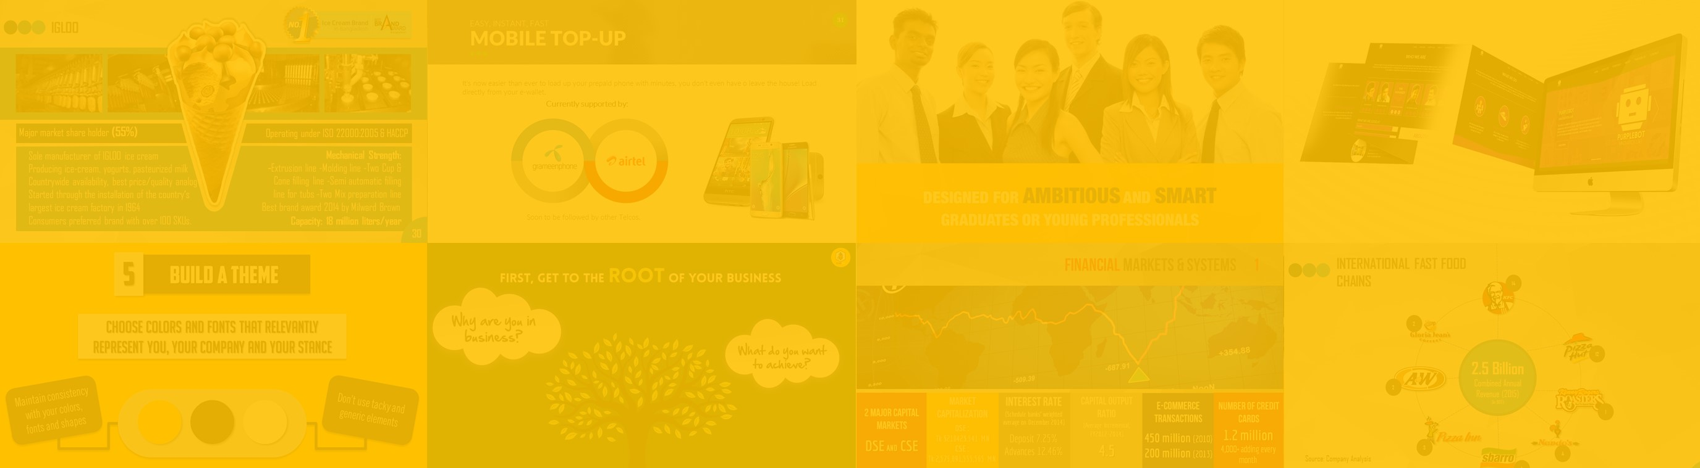


Hello!
This Template is Completely Customizable.
You can add, edit and remove any text/slide as you please. The info and slides provided are only guidelines.
Happy Pitching!
This Template Has Been Prepared By

Slide 3
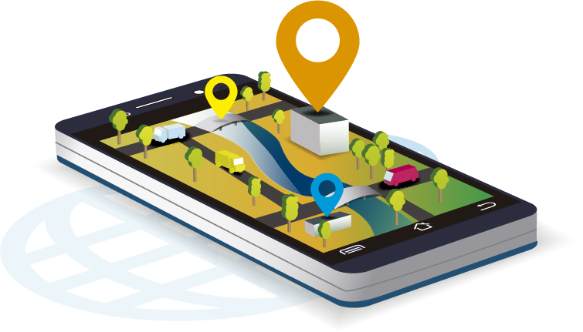
THE WORLD OF ONLINE NAVIGATION
EVENT PLATFORM APP
1 Billion+
12 Billion
THE NUMBER OF MILES GOOGLE MAPS PROVIDES NAVIGATION FOR EACH YEAR
USE GOOGLE MAPS EVERY MONTH
2.8 Million
2 YEARS
WEBSITES USE GOOGLE MAPS
TIME SAVED IN TRAFFIC PER DAY FOR USERS

Slide 4

THE THRIVING SOCIAL SCENE IN BANGLADESH
EVENT PLATFORM APP
Social media is becoming integrated with every facet of urban life.
10
MOST USERS ARE BETWEEN THE AGES OF
15-35
MIILLION FACEBOOK USERS
OLD
70%
EVENT PAGES
FACEBOOK USERS SPEND MORE THAN 1 HOUR ON SOCIAL MEDIA
ARE A POPULAR WAY OF RAISING AWARENESS ABOUT EVENTS

Slide 5
MAKING EVENTS TRULY SOCIAL
EVENT PLATFORM APP
Our app aims to create a thriving social media platform for events.
USP 1
USP 4
Sample Text
Sample Text
USP 2
USP 5
Sample Text
Sample Text
USP 3
USP 6
Sample Text
Sample Text

Slide 6



MEET THE COMPETITION
EVENT PLATFORM APP
Sample Text
Sample Text
Sample Text

Slide 7
WHAT THE CURRENT PLAYERS ARE DOING
EVENT PLATFORM APP
What is the current trend in the event platform market?
LIMITED INFORMATION
DETAILED INFORMATION
HIGH USER PARTICIPATION
Competitor
1
Provide insights about the current competitors in the industry.
Competitor
2
Competitor
5
Competitor
3
LOW USER PARTICIPATION
Competitor
4

Slide 8
OUR GROWTH SO FAR
EVENT PLATFORM APP
X
Z BDT
V
W
Y%
TOTAL SUBSCRIBERS
TOTAL EVENTS LISTED
DAILY TRAFFIC
SUBSCRIBER GROWTH
MONTHLY AD REVENUE

Slide 9
PROJECTIONS FOR THE FUTURE
EVENT PLATFORM APP
 | YEAR 1 | YEAR 3 | YEAR 5
Description and Text Goes here | 60,099 | 80,873 | 76,9838
Description and Text Goes here | 20,09 | 20,09 | 20,09
Description and Text Goes here | 20,09 | 20,09 | 20,09
Description and Text Goes here | 20,09 | 20,09 | 20,09
Description and Text Goes here | 20,09 | 20,09 | 20,09
Description and Text Goes here | 60.555 | 60.555 | 60.555
Description and Text Goes here | 85040 | 85040 | 85040
Description and Text Goes here | 85,09 | 85,09 | 85,09
TOTAL VALUE | BDT 2,000,900 | BDT 8,000,900 | BDT 10,000,900

Slide 10
KEY FINANCIAL SNAPSHOTS
EVENT PLATFORM APP
2020 Projections
U BDT
V BDT
W%
Total Revenue
Total Investment
ROI
X BDT
Y%
Z BDT
NPV
IRR
Net Cash Flow

Slide 11
HOW YOU CAN HELP US GROW
EVENT PLATFORM APP
Future Goal 4
Sample Text
Future Goal 3
Sample Text
Future Goal 2
Sample Text
Future Goal 1
Sample Text

Slide 12
MEET THE TEAM
EVENT PLATFORM APP
Name
Name
Name
Name
Position
Position
Position
Position

Slide 13
CONTACT US!
EVENT PLATFORM APP
Location
Website
Facebook Page
Email
Phone
Sample Text
Sample Text
Sample Text
Sample Text
Sample Text

Slide 14
EVENT PLATFORM APP
ICONS LIST

